Slide 1
LESSON 19

Slide 2
Overview
of
Previous Lesson(s)

Slide 3
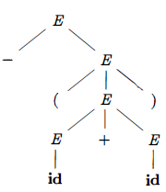
Over View
A parse tree is a graphical representation of a derivation that filters out the order in which productions are applied to replace non-terminals
The leaves of a parse tree are labeled
by non-terminals or terminals and,
read from left to right constitute a sentential form, called the yield or frontier of the tree.

Slide 4
Over View..
A grammar that produces more than one parse tree for some sentence is said to be ambiguous
Alternatively, an ambiguous grammar is one that produces more than one leftmost derivation or more than one rightmost derivation for the same sentence.
Ex Grammar E → E + E | E * E | ( E ) | id
It is ambiguous because we have seen two parse trees for id + id * id

Slide 5

Over View...
An ambiguous grammar can be rewritten to eliminate the ambiguity.
Ex. Eliminating the ambiguity from the following dangling-else grammar:
Compound conditional statement
if E₁ then S₁ else if E₂ then S₂ else S₃

Slide 6
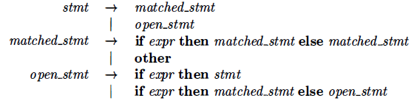
Over View...
Rewrite the dangling-else grammar with the idea:
A statement appearing between a then and an else must be matched that is, the interior statement must not end with an unmatched or open then.
A matched statement is either an if-then-else statement containing no open statements or it is any other kind of unconditional statement.

Slide 7
Over View...
A grammar is left recursive if it has a non-terminal A such that there is a derivation A ⇒⁺ Aα for some string α
Top-down parsing methods cannot handle left-recursive grammars, so a transformation is needed to eliminate left recursion.
We already seen removal of Immediate left recursion i.e
A → Aα + β A → βA’
A’ → αA’ | ɛ

Slide 8
Over View...
Generic Method
A → Aα₁ | Aα₂ | … | Aα_{m} | β₁ | β₂ | … | β_{n}
Then the equivalent non-recursive grammar is
A → β₁A’ | β₂A’ | … | β_{n}A’
A’ → α₁A’ | α₂A’ | … | α_{m}A’ | ɛ
The non-terminal A generates the same strings as before but is no longer left recursive.

Slide 9

Over View...
Left factoring is a grammar transformation that is useful for producing a grammar suitable for predictive, or top-down, parsing.
If two productions with the same LHS have their RHS beginning with the same symbol (terminal or non-terminal), then the FIRST sets will not be disjoint so predictive parsing will be impossible
Top down parsing will be more difficult as a longer lookahead will be needed to decide which production to use.
Ex.

Slide 10
Over View...
if A → αβ₁ | αβ₂ are two A-productions
Input begins with a nonempty string derived from α
We do not know whether to expand A to αβ₁ or αβ₂
However , we may defer the decision by expanding A to αA'
After seeing the input derived from α we expand
A' to β₁ or A' to β₂.
After removing left-factoring.
A → α A’
A' → β₁| β₂

Slide 11
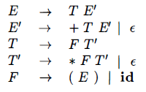
Over View...
Top-down parsing can be viewed as the problem of constructing a parse tree for the input string, starting from the root and creating the nodes of the parse tree in preorder (DFT).
If this is our grammar then the steps involved in construction of a parse tree are

Slide 12
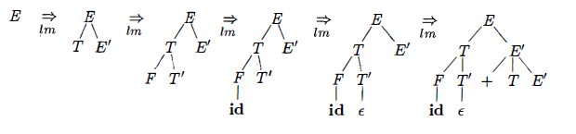
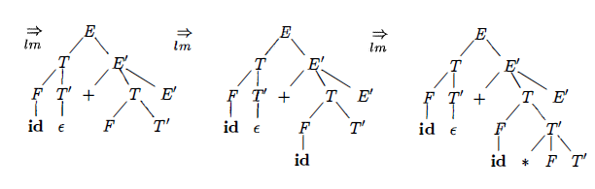
Over View...
Top Down Parsing for id + id * id

Slide 13
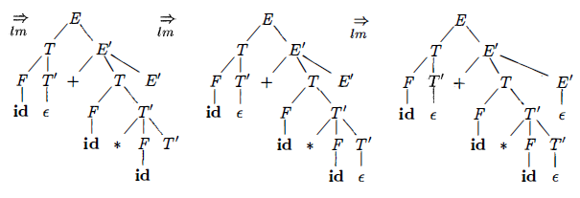
Over View...
Consider a node labeled E' .
At the first E' node (in preorder) , the production E’ → +TE’ is chosen; at the second E’ node, the production E’ → ɛ is chosen.
A predictive parser can choose between E’-productions by looking at the next input symbol.

Slide 14
Over View...
Recursive Descent Parsing
It is a top-down process in which the parser attempts to verify that the syntax of the input stream is correct as it is read from left to right.
A basic operation necessary for this involves reading characters from the input stream and matching then with terminals from the grammar that describes the syntax of the input.
Recursive descent parsers will look ahead one character and advance the input stream reading pointer when proper matches occur.

Slide 15
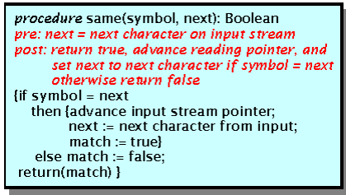
Over View...
Procedure that accomplishes matching and reading process.
The variable called 'next' looks ahead and always provides the next character that will be read from the input stream.

Slide 16
TODAY’S LESSON

Slide 17
Contents
Top Down Parsing
Recursive Decent Parsing
FIRST & FOLLOW
LL(1) Grammars
Non-recursive Predictive Parsing
Error Recovery in Predictive Parsing
Bottom Up Parsing
Reductions
Handle Pruning
Shift-Reduce Parsing
Conflicts During Shift-Reduce Parsing
Introduction to LR Parsing

Slide 18
Recursive Decent Parsing...
What is a 'nice' grammar.?
The grammar which has the following properties can be categorized as nice:
A grammar must be deterministic.
Left recursion should be eliminated.
It must be left factored.

Slide 19
FIRST & FOLLOW
The construction of both top-down and bottom-up parsers is aided by two functions, FIRST and FOLLOW associated with a grammar G.
During top-down parsing, FIRST and FOLLOW allows us to choose which production to apply, based on the next input symbol.
During panic-mode error recovery sets of tokens produced by FOLLOW can be used as synchronizing tokens.
The basic idea is that FIRST(α) tells you what the first terminal can be when you fully expand the string α and FOLLOW(A) tells what terminals can immediately follow the non-terminal A

Slide 20
FIRST & FOLLOW..
FIRST(A → α) is the set of all terminal symbols x such that some string of the form xβ can be derived from α
FIRST:
For any string α of grammar symbols, we define FIRST(α) to be the set of terminals that occur as the first symbol in a string derived from α.
So, if α⇒*xβ for x a terminal and β a string, then x is in FIRST(α).
In addition if α⇒*ε then ε is in FIRST(α).

Slide 21
FIRST & FOLLOW...
The follow set for the non-terminal A is the set of all terminals x for which some string αAxβ can be derived from the starting symbol S
FOLLOW:
For any non-terminal A FOLLOW(A) is the set of terminals x that can appear immediately to the right of A in a sentential form.
Formally, it is the set of terminals x such that S⇒*αAxβ.
In addition, if A can be the rightmost symbol in a sentential form, the end marker $ is in FOLLOW(A)

Slide 22
FIRST & FOLLOW...
To compute FIRST(X) for all grammar symbols X apply the following rules until no more terminals or ɛ can be added to any FIRST set
If X is a terminal then FIRST(X)={X}
If X → ε is a production, add ε to FIRST(X)
Initialize FIRST(X)=φ for all non-terminals X
For each production X → Y_{1,} Y₂ ... Y_{n} add to FIRST(X) any terminal a satisfying
a is in FIRST(Y_{i}) and
ε is in all previous FIRST(Y_{j})

Slide 23
FIRST & FOLLOW...
Repeat this step until nothing is added.
FIRST of any string X=X₁X₂...X_{n} is initialized to φ and then
add to FIRST(X) any non-ε symbol in FIRST(X_{i}) if ε is in all previous FIRST(X_{j})
add ε to FIRST(X) if ε is in every FIRST(X_{j}) In particular if X is ε FIRST(X)={ε}

Slide 24
FIRST & FOLLOW...
To compute FOLLOW(X) for all non-terminals X, apply the following rules until nothing can be added to any FOLLOW set.
Initialize FOLLOW(S)=$ and FOLLOW(X)=φ for all other non-terminals X, and then apply the following 03 rules until nothing is added to any FOLLOW set.
For every production X → αYβ add all of FIRST(β) except ε to FOLLOW(Y)
For every production X → αY add all of FOLLOW(X) to FOLLOW(Y)
For every production X → αYβ where FIRST(β) contains ε add all of FOLLOW(X) to FOLLOW(Y)

Slide 25
FIRST & FOLLOW...
Ex: E → T E’
E’ → + T E’ | ɛ
T → F T’
T’ → *FT’ | ɛ
F → (E) | id
FIRST(F) = FIRST(T) = FIRST(E) = { ( , id }
Two productions for F have bodies that start with these two terminal symbols, id and the left parenthesis
T has only one production, and its body starts with F. Since F does not derive ɛ, FIRST(T) must be the same as FIRST(F)
The same argument covers FIRST(E)

Slide 26
FIRST & FOLLOW...
FIRST(E’) = {+, ɛ }
The reason is that one of the two productions for E‘ has a body that begins with terminal + and the other's body is ɛ
Whenever a non-terminal derives ɛ we place ɛ in FIRST for that non-terminal.
FIRST(T’) = {*, ɛ }
The reasoning is analogous to that for FIRST(E’)
FOLLOW(E) = FOLLOW(E') = {), $}
Since E is the start symbol, FOLLOW(E) must contain $.
The production body (E) explains why the right parenthesis is in FOLLOW(E) For E‘ this non-terminal appears only at the ends of bodies of ɛ-productions
Thus, FOLLOW(E’) must be the same as FOLLOW(E)

Slide 27
FIRST & FOLLOW...
FOLLOW(T) = FOLLOW(T') = {+, ) , $}
T appears in bodies only followed by E’ Thus, everything except ɛ that is in FIRST(E') must be in FOLLOW(T) that explains the symbol +.
However, since FIRST(E') contains ɛ (i.e. , E' =* t), and E' is the entire string following T in the bodies of the ɛ-productions, everything in FOLLOW(E) must also be in FOLLOW(T)
That explains the symbols $ and the right parenthesis.
As for T' since it appears only at the ends of the T-productions it must be that FOLLOW(T') = FOLLOW(T)
FOLLOW(F) = {+, *, ), $}

Slide 28
LL(1) Grammars
Predictive parsers that is recursive-descent parsers needing no backtracking, can be constructed for a class of grammars called LL(1).
The first "L" in LL(1) stands for scanning the input from left to right.
The second "L" for producing a leftmost derivation.
“1" for using one input symbol of look ahead at each step to make parsing action decisions.

Slide 29
LL(1) Grammars..
The class of LL(1) grammars is rich enough to cover most programming constructs.
No left-recursive or ambiguous grammar can be LL(1)
A grammar G is LL(1) iff A → α | β are two distinct productions of G and hold following conditions:
For no terminal a do both α and β derive strings beginning with a
At most one of α and β can derive the empty string.
If β ⇒* ɛ then α does not derive any string beginning with a terminal in FOLLOW(A)
Likewise, if α ⇒* ɛ then β does not derive any string beginning with a terminal in FOLLOW(A)

Slide 30
LL(1) Grammars...
The first two conditions are equivalent to the statement that FIRST(α) and FIRST(β) are disjoint sets.
The third condition is equivalent to stating that if ɛ is in FIRST(β) then FIRST(α) and FOLLOW(A) are disjoint sets.
The last condition is similar that if ɛ is in FIRST(α) then FIRST(β) and FOLLOW(A) are disjoint sets.

Slide 31
LL(1) Grammars...
Predictive Parsing Table
M [A,a] a two-dimensional array.
where A is a non-terminal.
a is a terminal or the symbol $, the input end-marker.
The goal is to produce a table telling us at each situation which production to apply.
A situation means a non-terminal in the parse tree and an input symbol in look-ahead.

Slide 32
LL(1) Grammars...
So we saw the method which produces a table with rows corresponding to non-terminals and columns corresponding to input symbols (including $, the end-marker).
In an entry we put the production to apply when we are in that situation.
INPUT: Grammar G.
OUTPUT: Parsing Table M.

Slide 33
LL(1) Grammars...
METHOD:
For each production A → α do the following
For each terminal a in FIRST(α) add A → α to M[A,a] This is what we did with predictive parsing earlier. The point was that if we are up to A in the tree and a is the look-ahead, we could (should??) use the production A→α.
If ε is in FIRST(α) then for each terminal b in FOLLOW(A) add A → α to M[A,a] If ε is in FIRST(α) and $ is in FOLLOW(A) add A → α to M[A,$] as well.

Slide 34
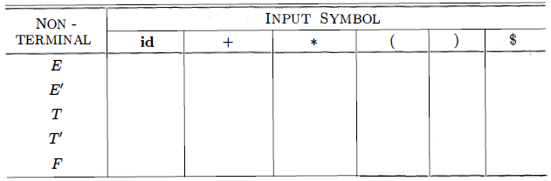
LL(1) Grammars...
Ex. E → T E’ FIRST(F) = FIRST(T) = FIRST(E) = { ( , id }
E’ → + T E’ | ɛ FIRST(E’) = {+, t}
T → F T’ FIRST(T’) = {*,t}
T’ → *FT’ | ɛ FOLLOW(E) = FOLLOW(E') = {), $}
F → (E) | id FOLLOW(T) = FOLLOW(T') = {+, ) , $}
FOLLOW(F) = {+, *, ), $}

Slide 35
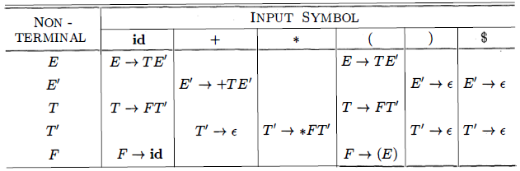
LL(1) Grammars...
Parsing table M

Slide 36
Thank You

